Slide 1
CONTROLLED ACCESS
In controlled access, the stations consult one another to find which station has the right to send. A station cannot send unless it has been authorized by other stations.

Slide 2
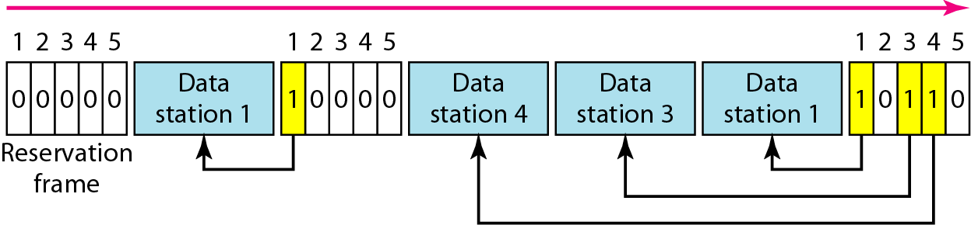
Reservation access method

Slide 3
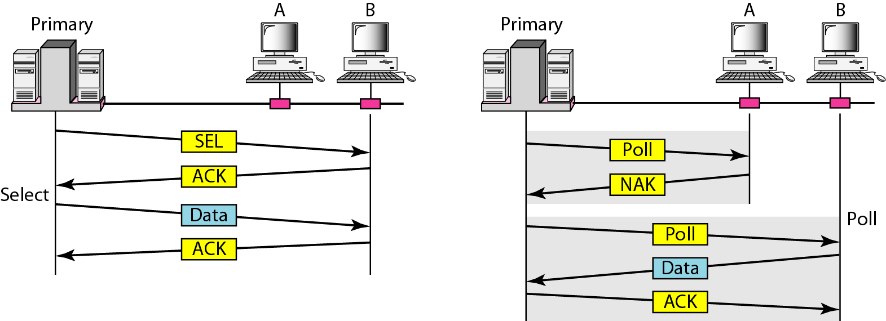
Select and poll functions in polling access method

Slide 4
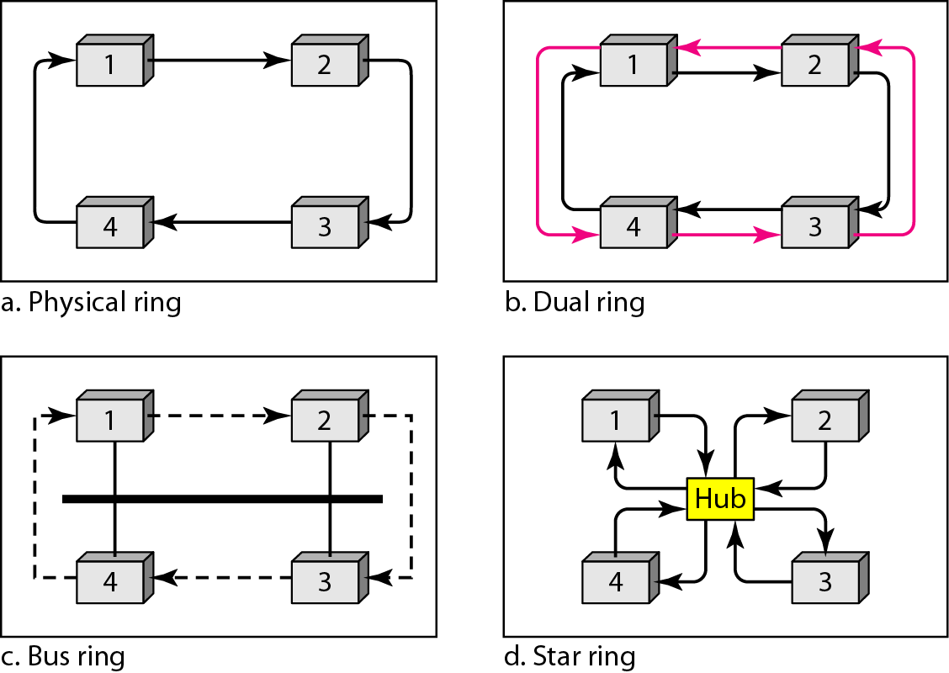
Logical ring and physical topology in token-passing access method

Slide 5
Wired LANs: Ethernet

Slide 6
IEEE STANDARDS
In 1985, the Computer Society of the IEEE started a project, called Project 802, to set standards to enable intercommunication among equipment from a variety of manufacturers. Project 802 is a way of specifying functions of the physical layer and the data link layer of major LAN protocols.

Slide 7
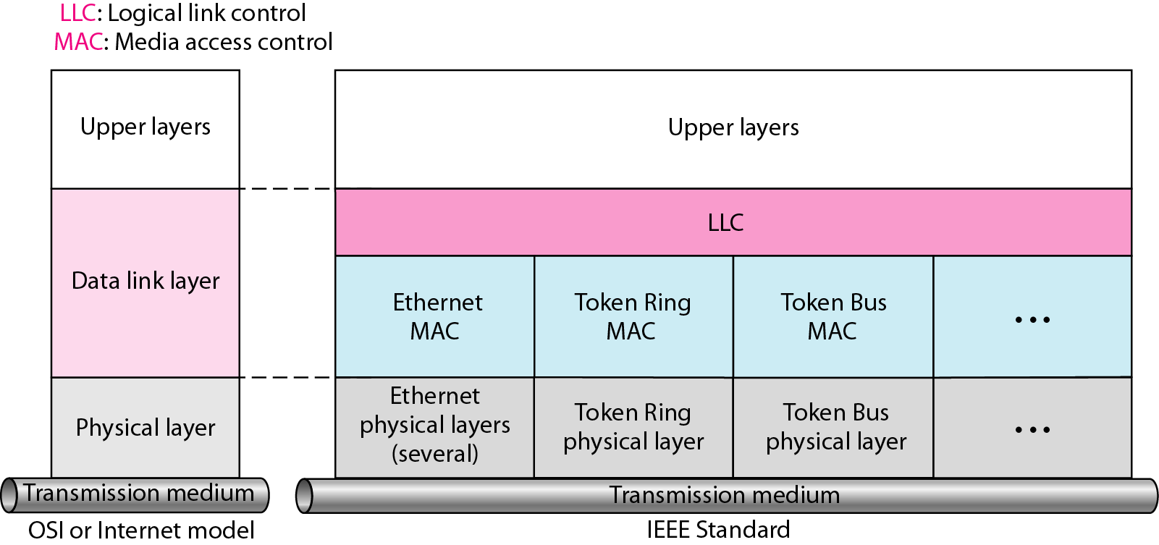
IEEE standard for LANs

Slide 8
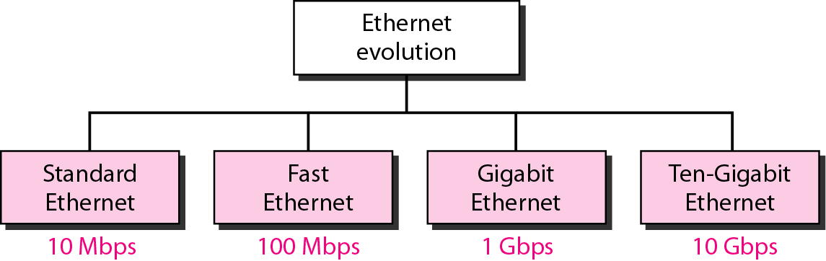
Ethernet evolution through four generations

Slide 9
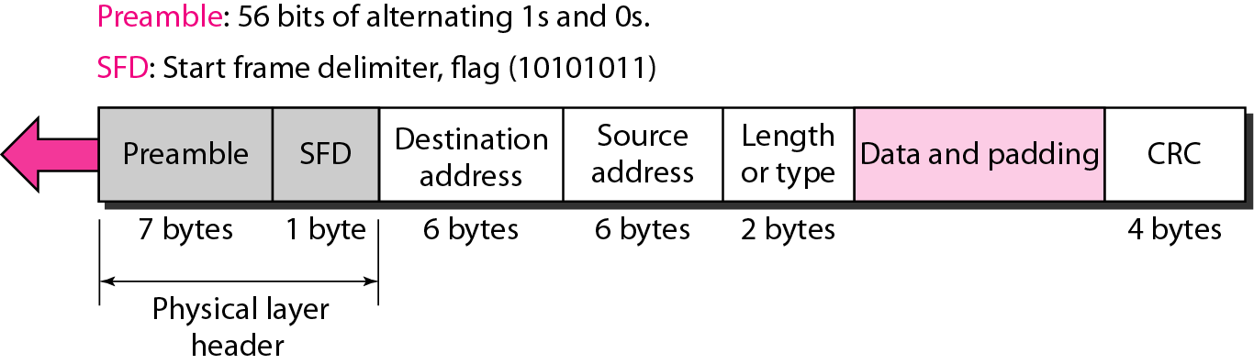
802.3 MAC frame

Slide 10
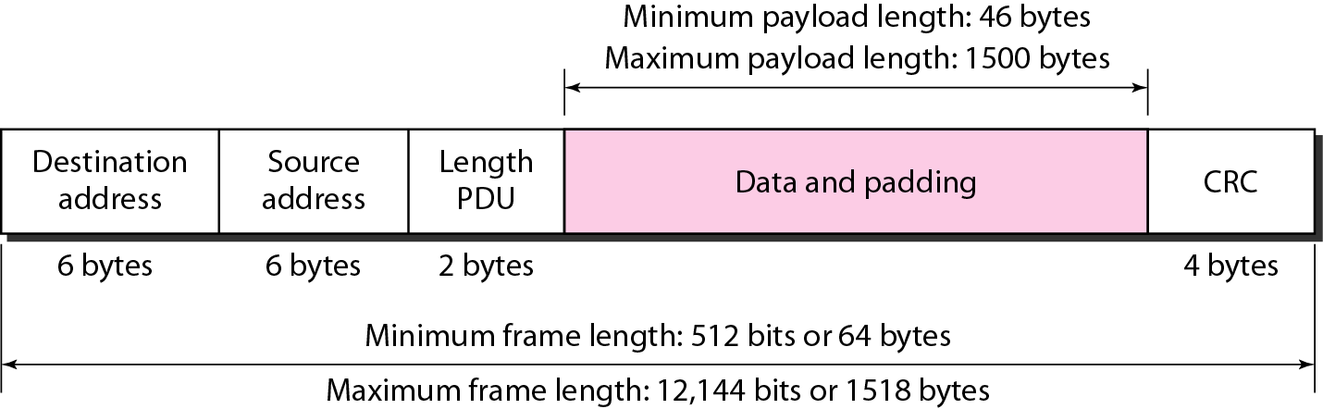
Minimum and maximum lengths

Slide 11
Frame length:
Minimum: 64 bytes (512 bits) Maximum: 1518 bytes (12,144 bits)

Slide 12
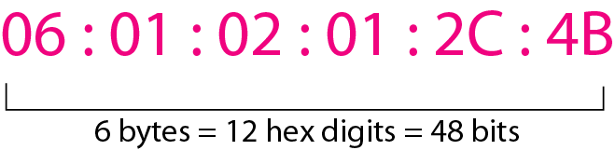
Example of an Ethernet address in hexadecimal notation

Slide 13
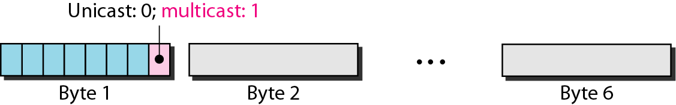
Unicast and multicast addresses

Slide 14
The least significant bit of the first byte defines the type of address. If the bit is 0, the address is unicast; otherwise, it is multicast.

Slide 15
The broadcast destination address is a special case of the multicast address in which all bits are 1s.

Slide 16
Example
Define the type of the following destination addresses:
a. 4A:30:10:21:10:1A b. 47:20:1B:2E:08:EE
c. FF:FF:FF:FF:FF:FF
Solution
To find the type of the address, we need to look at the second hexadecimal digit from the left. If it is even, the address is unicast. If it is odd, the address is multicast. If all digits are F’s, the address is broadcast. Therefore, we have the following:
a. This is a unicast address because A in binary is 1010.
b. This is a multicast address because 7 in binary is 0111.
c. This is a broadcast address because all digits are F’s.

Slide 17
Example
Show how the address 47:20:1B:2E:08:EE is sent out on line.
Solution
The address is sent left-to-right, byte by byte; for each byte, it is sent right-to-left, bit by bit, as shown below:

Slide 19
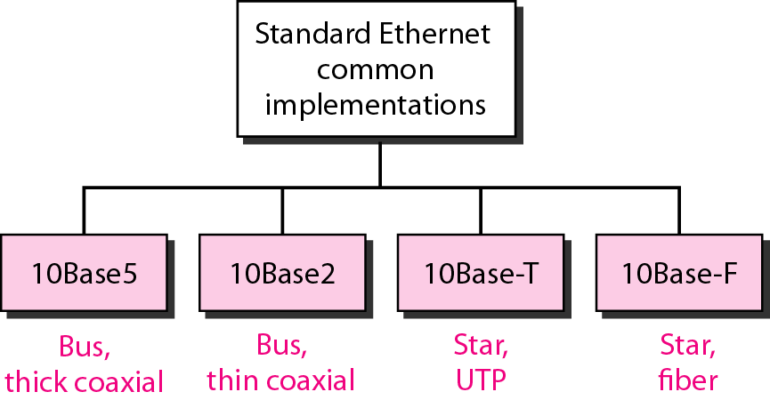
Categories of Standard Ethernet

Slide 20
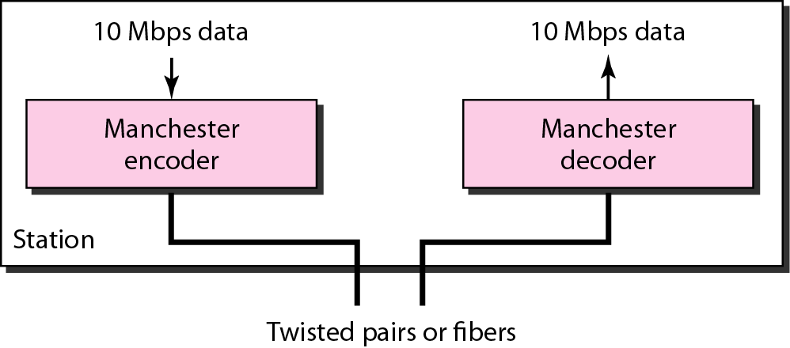
Encoding in a Standard Ethernet implementation

Slide 21
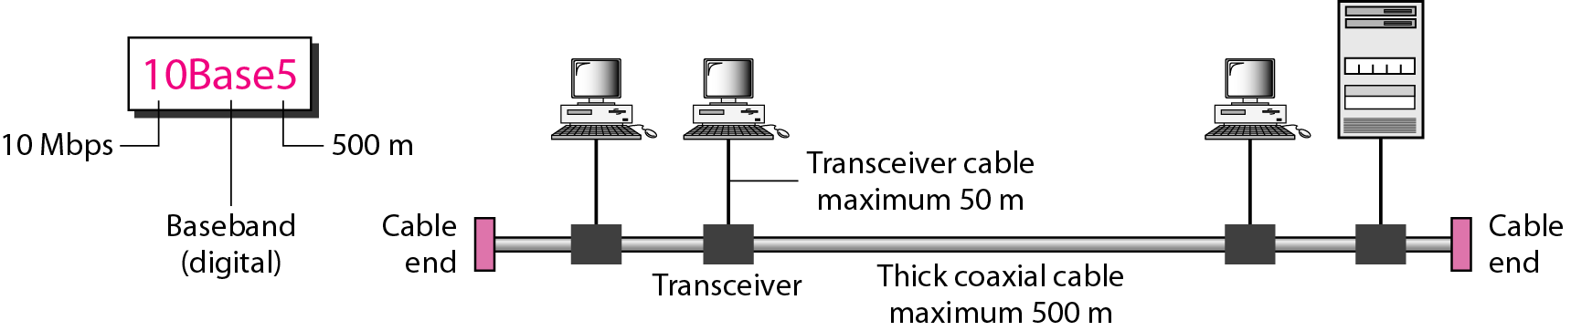
10Base5 implementation

Slide 22
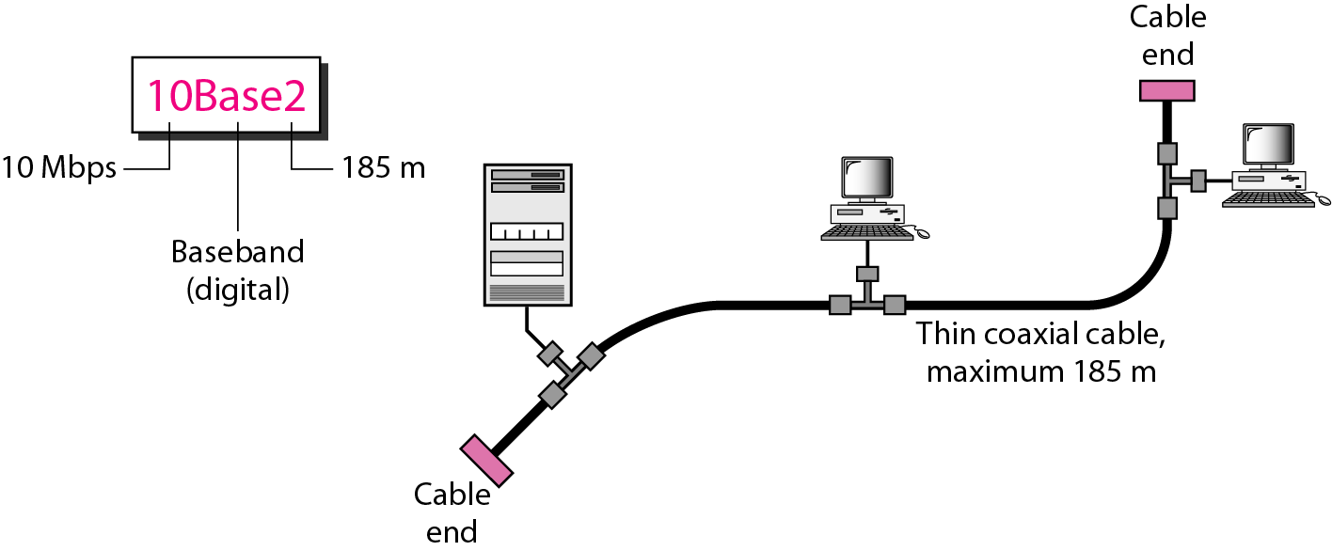
10Base2 implementation

Slide 23
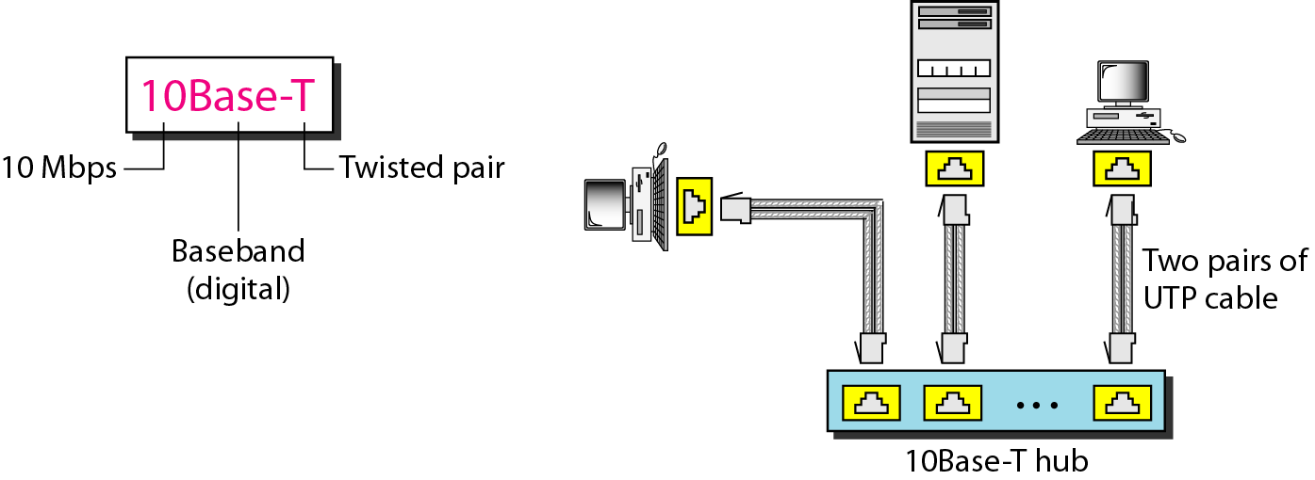
10Base-T implementation

Slide 24
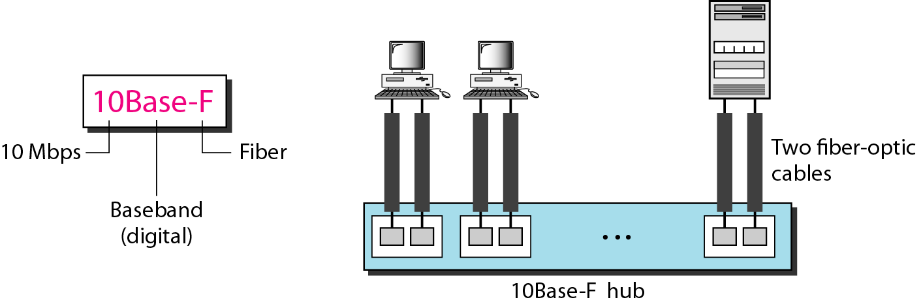
10Base-F implementation

Slide 25
Table Summary of Standard Ethernet implementations

